Slide 1

NEW YORK
CITY
NEIGHBORHOODS
CLUSTERING
HUSSAM AL HAMDAN
NATALIA KRAVCHENKO

Slide 2
01
GOAL
Identify New York city neighborhoods which are most suitable for relocation of families with young kids.

Slide 3
Parse data from
Foursquare, Yelp, Google APIs and Uber datasets
Prepare data (cleaning, scaling, encoding, binning)
Download
neighborhood data from JSON
file
Brainstorm
features
Describe
clusters with features and economic data
Cluster data using Kmeans, Hierarchical model, DBScan with/without PCA
Evaluate with Sihlouette score and inertia
02

Slide 4




03
VENUES
RESTAURANTS
SCHOOLS
BUS STOPS
VENUES
RESTAURANTS
SCHOOLS
EVENTS
VENUES
HEALTH CARE
FACILITIES
BUS STOPS
DAILY NUMBER OF RIDES

Slide 5
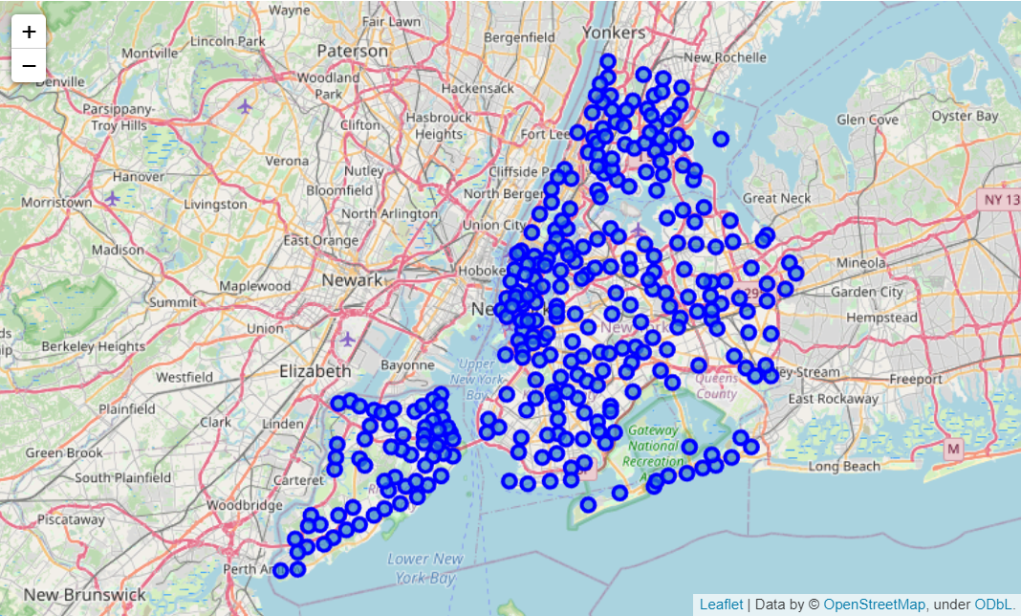
NYC NEIGHBORHOODS
04

Slide 6
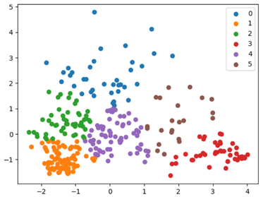
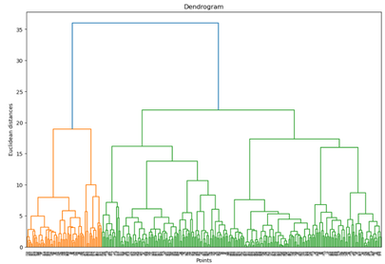
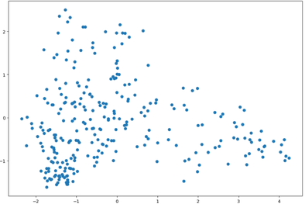
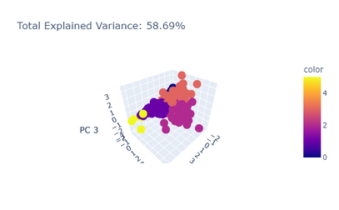
05
CLUSTERING TECHNIQUES
Kmeans - best overall option with Elbow rule to define number of clusters
Hierarchical- Helpful to with defining number of clusters. Results similar to Kmeans
DBScan - Too sensitive to noise, worked well only with big number of clusters
PCA - helpful to visualize but did not add much to the score and was hard to interpret

Slide 7
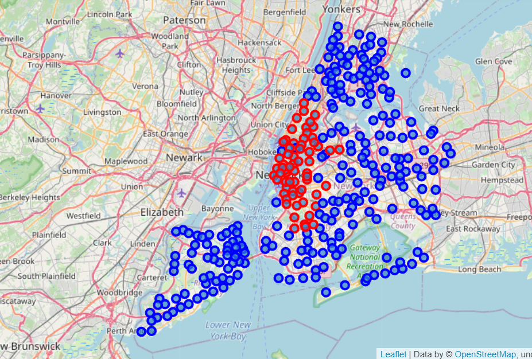
2 CLUSTERS
ALWAYS SEPARATE DOWNTOWN NO MATTER WHAT FEATURES ARE USED FOR CLUSTERING
06

Slide 8
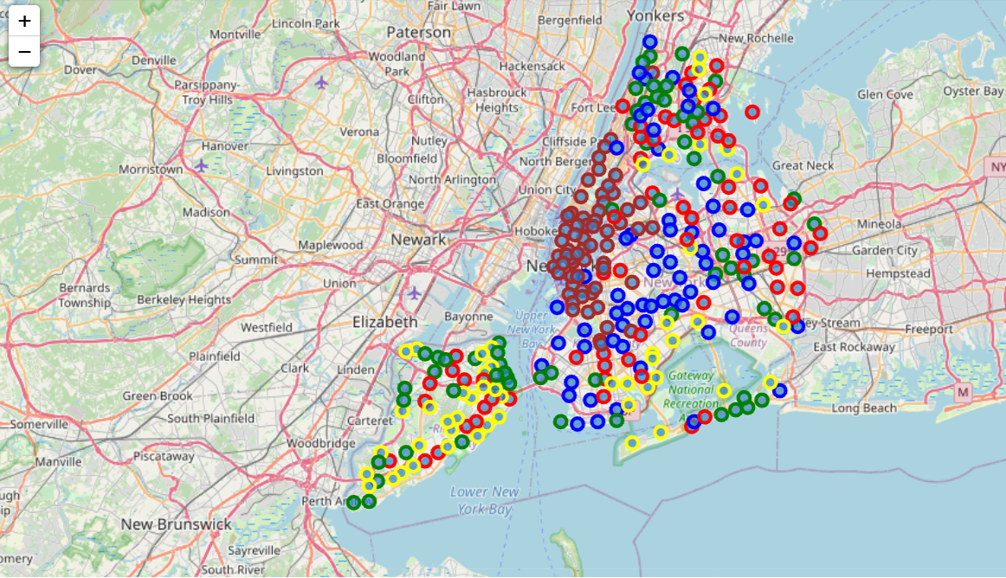
5 CLUSTERS WITH BINNED NUMERICALS
BLUE CLASTER IS THE ONE TO RECOMMEND FOR RELOCATING FAMILIES
07

Slide 9
CLUSTER | N of Restaurants | N of Health Care Facilities | N of Schools | N of Bus Stops | N of Events | Daily Uber rides | 2 BR apartment rent, USD
1 | Medium | Medium_low | Medium | Low | Low | Medium | 2103.07
2 | Medium | Medium_low | Medium | Low | Low | Low | 2004.03
3 | Medium_low | Low | Low | Medium | Low | Low | 2219.66
4 | Low | Low | Low | Low | Low | Low | 1982.35
5 | High | Low | Low | Low | High | High | 3206.38
Cluster 2 is optimal in terms of number of schools, healthcare facilities availability and housing price.
Cluster 1 is the second choice.
Cluster 5 is Downtown.
08

Slide 10

Interesting fact:
Vietnamese restaurants are the most popular ones in 1st, 2nd and 3rd clusters.
In 4th and 5th clusters Yemeni restaurants are leading
10

Slide 11

API SET UP
LOW SPEED OF CODING
DATA INCONSISTENCY
DECISION MAKING
11
Challenges

Slide 12
12
MORE ECONOMIC AND DEMOGRAOHIC DATA CAN BE USED TO DESCRIBE CLUSTERS
USING BBOX INSTEAD OF COORDINATES/RADIUS TO ASSIGN HEIGHBORHOODS MORE ACCURATELY
ADD SCHOOL RANKING AS A FEATURE
ADD ENTERTAINMENT AND NATURAL FACILITIES AS FEATURES
Plans

Slide 13

THANK YOU
13

